Slide 1
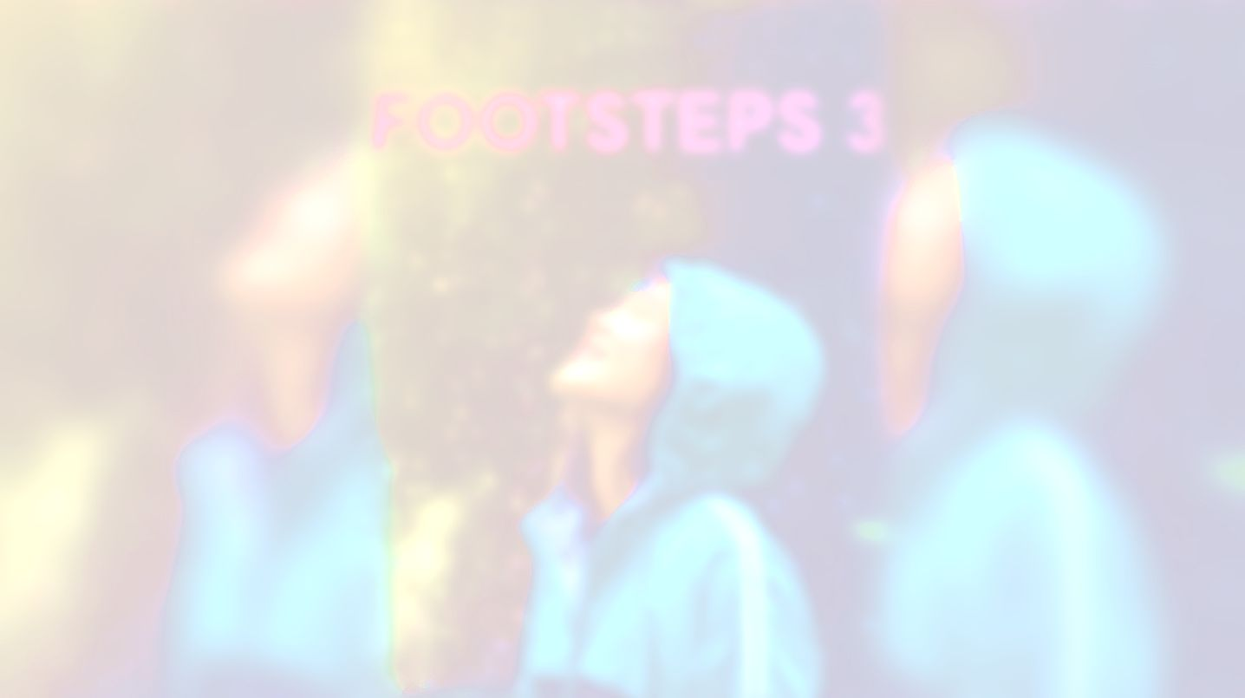
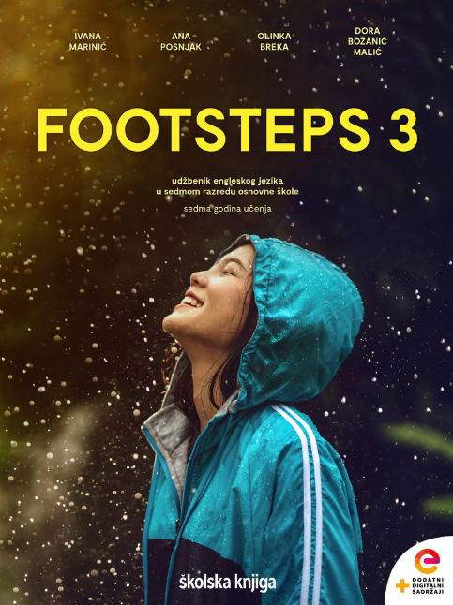

CULTURE SPOT 2;
Rural, urban, rural

Slide 2
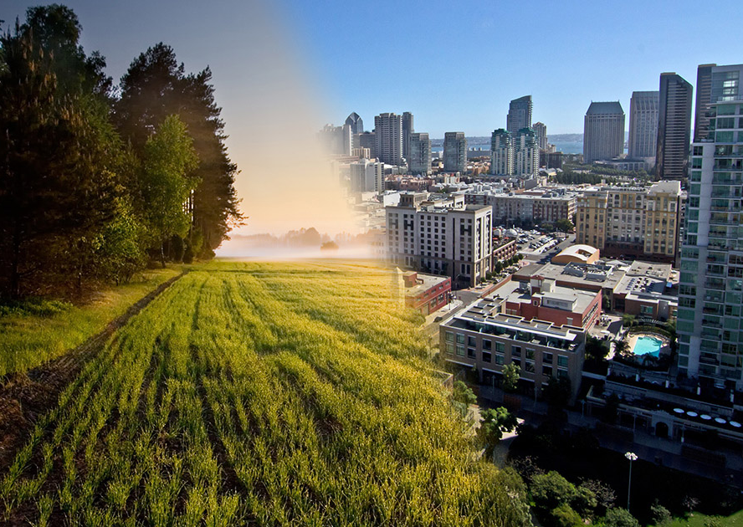
What urban areas do you immediately think of when you think of America?
Can you name some rural areas?
What is the main difference between cities and small towns?
What are the typical problems facing a person who lives in a big city vs small town?

Slide 3
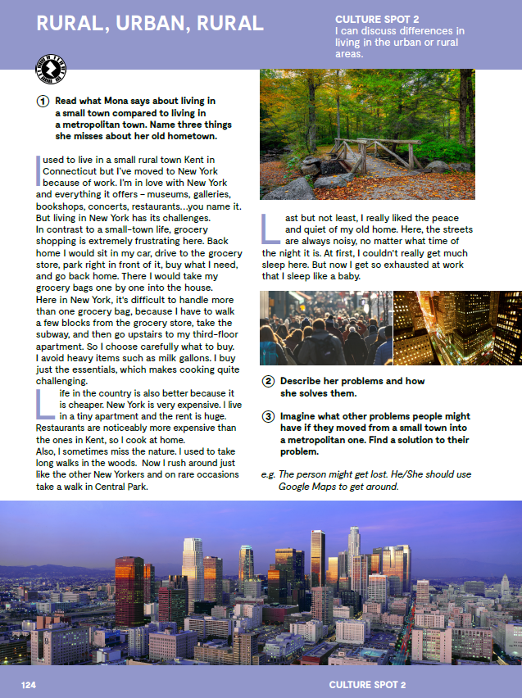
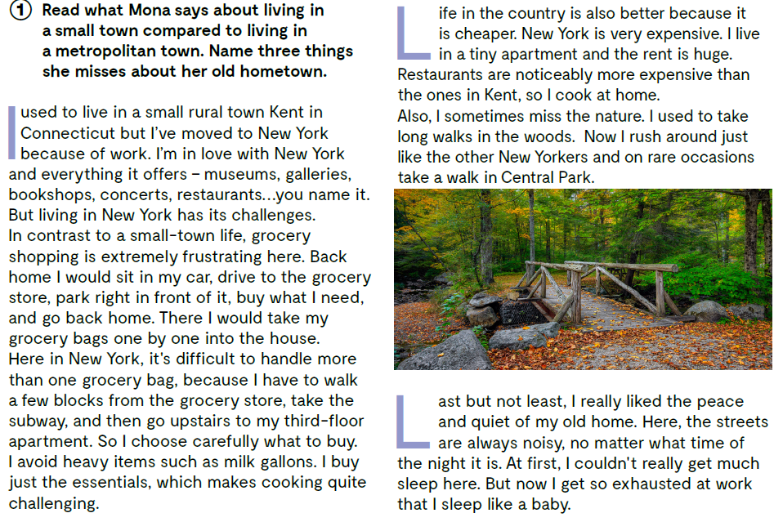

Slide 4


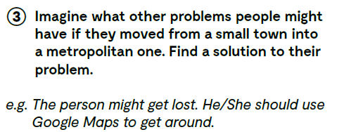

Slide 5
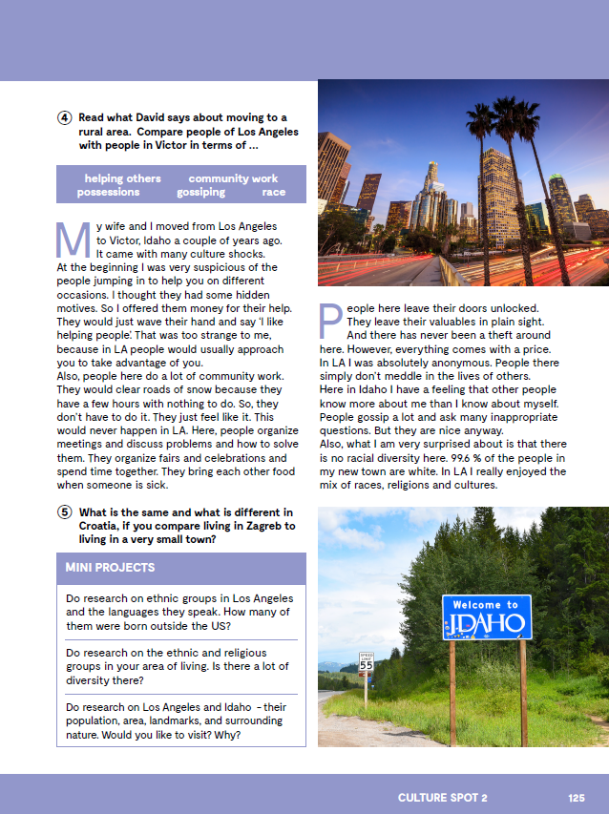
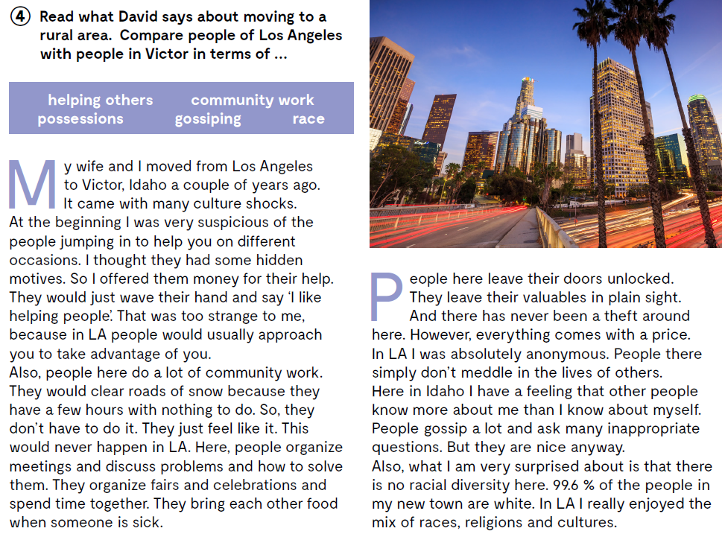
Let’s practise:
https://learningapps.org/watch?v=p9gfa9sdj20

Slide 6


